Slide 1
Data Cleaning
Meeting 2
06/27/2021

Slide 2
Bitcoin
New data sets
46% of total market value. High correlations with other cryptos.
Since the data I purchased was not ideal, let’s take a harder look on bitcoin first.
Data is free and good quality.
We will encounter new problems. Just solve them.

Slide 3
Set Up Quandl
1. Search Quandl and set up your account.
2. Search Data named Blockchain. It is free data.
3. Open Juypter Notebook.
1) pip install quandl
2) import quandl
3)import pandas as pd

Slide 4
Load Data
1. Find your API key in your account settings.
2. mydata = quandl.get(‘Code’);
3. multiple pages of data, load in “all” of them and make them be in the same table based on date. (Besides the Price) (Date must match)
4. Classify Y (Price tomorrow - Price Today) / Price Today
5. Clean NaN

Slide 5
Should we do data differently
Moving Average 2 days, 5 days

Slide 6
Date Match
Date_Vec = []
for i in Volume['Date’]: for j in Data_Collection['Date']:
if i == j:
Date_Vec.append(i)
Collection[‘Volume’] =volume.loc[Date_Vec, ‘MA_2’]

Slide 7
06/29 Problems and Concerns
The way we used fillna, roll() was too aggressive and not well thought.
There are many 0 value terms (more than 1000 cells) in some columns.
It is not right to fill the value from the previous cell to the next one (Volume)

Slide 8
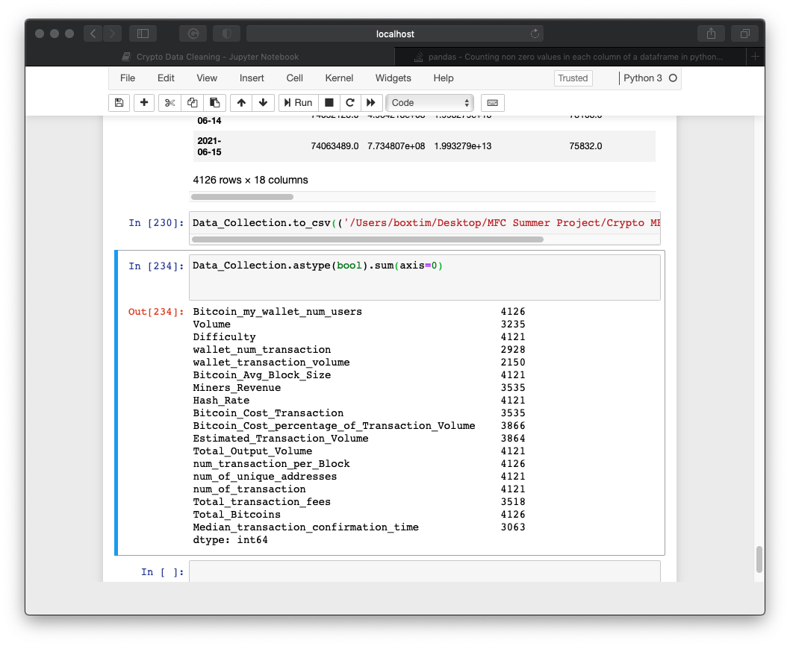

Slide 9
06/29
1. Finish the leftovers from yesterday. (Use my Table directly and .roll all columns)
2. Perfect our data
#1) Start Date: 02/22/2012 (Get rid of all previous data)
#2) Get rid of column F (Wallet_transaction_volume)
#3) Take care of Volume = 0; wallet_num_transaction = 0
#4) fill most 0 cell with avg number of previous and next cells for each column

Slide 10
06/29
2. Finish Y
1) Load Historical Price
2) (Price tomorrow – Price today) / price today = x
3) if x >= 0.1 ➔ Y = 1; elif 0.1 < x <0 ➔ Y = 2; else (x<0) ➔ Y = 3
4) Match Date Data with Data_Collection
5) Training Data: 2100; Test Data: 430; Critical Valuation: 451 (for me)
70%, 15%, 15%

Slide 11
Load Data Matlab
T = readtable(‘xxx’)
A = tabletoarray(T(:,2)) % transform table to array

Slide 12

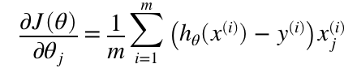
Cost Function (Unregularized)

Slide 13
Cost Fun reg
Find regularized Cost function J: add (lambda/2m) * sum(theta^2) to Unreg cost func
sum starts from 1, exclude theta0 since X0 = 1
Find regularized Grad descent by adding (lambda/m) * theta to unreg grad

Slide 14
Classifier & Predict
Y has 3 classes 1 ,2 ,3
For each class, we use fmincg function to find the most fitted thetas for our Data (X)
E.g. for class 1: theta_class1 = [t1,t2,t3,t4…..,t17]
For predict.m. think the (x2018) data for 2018/01/28== which class does it belong to?
Combine x2018 with class1 theta === 0.3 (probability that x2018 is class1)
Combine x2018 with class2 theta === 0.6 (probability x2018 is class2)
….. With class3 theta === 0.8 (we are 80% sure that x2018 is class 3)
Taking the max probability === x2018 is class3

